Slide 1
IEEE SRS DOCUMENT
SUBMITTED BY :
SUMAN NANDI (2K20/SWE/23)
TARUN KHARKWAL (2K20/SWE/24)

Slide 2
Definition
Software requirements Document (SRS) is used as a legal document which acts as a contract between customers and developers.
On the basis of this document developers know what to build and customers know what to expect.
This document may also be used to validate that the built system satisfies the requirements.

Slide 3
What is Software Requirement
Specification (SRS)
SRS is the official statement of what the system developers should implement.
SRS should include both a definition of user requirement and a specification of system requirements.

Slide 4
Purpose
Defines the software that will be built
Contains the requirement of the software.
Helps in designing the software.
Provide feedback to the customer.

Slide 5
Nature of SRS Document
Functionality: What functions the software is supposed to perform?
External interfaces: With what all external entities does the system interact? This may include the number of users, response time, recovery time, processing time, etc.
Performance: How does the software address performance issues? This may include people, hardware, external databases, etc.

Slide 6
Nature of SRS Document
Quality attributes: These may include availability, correctness, maintainability, portability, reliability, security, testability, etc. These non-functional requirements should also be properly placed in the SRS document.
Design constraints imposed on implementation: This may include limitations of the operating environment, programming language, database, resources, policies for database integrity, etc.
Cont.

Slide 7
User of Requirement Document
Customer
Mangers
System Engineers
System Test Engineers
System Maintenance Engineers

Slide 8
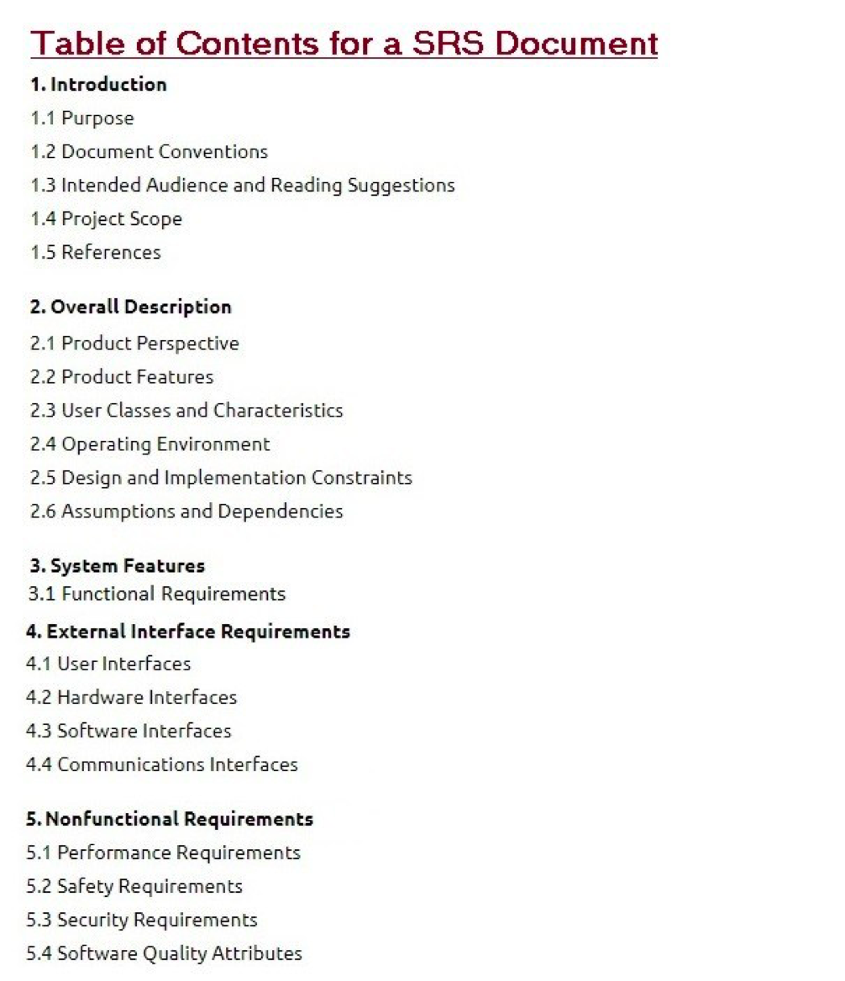
Content of SRS Document

Slide 9
Characteristics of a good SRS
Correct
Unambiguous
Complete
Consistent
Ranked importance
Verifiable
Modifiable
Traceable

Slide 10
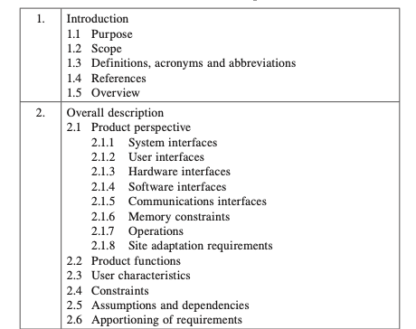
Explanation
Cont.

Slide 11
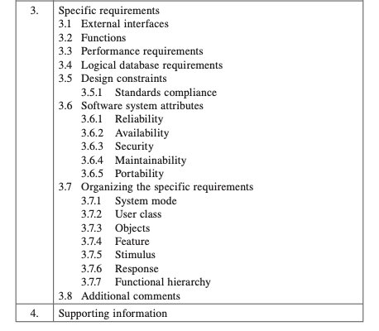

Slide 12
Library Management System as SRS
Purpose:
The library management system (LMS) maintains the information about various books available in the library. The LMS also maintains records of all the students, faculty and employees in the university. These records are maintained in order to provide membership to them.

Slide 13
Scope
Assign a name to the software under development.
List the functions which will be provided and also those functions which the software will not do.
Explain the applications of the software along with possible benefits and objectives.
Maintain consistency amongst statements.

Slide 14
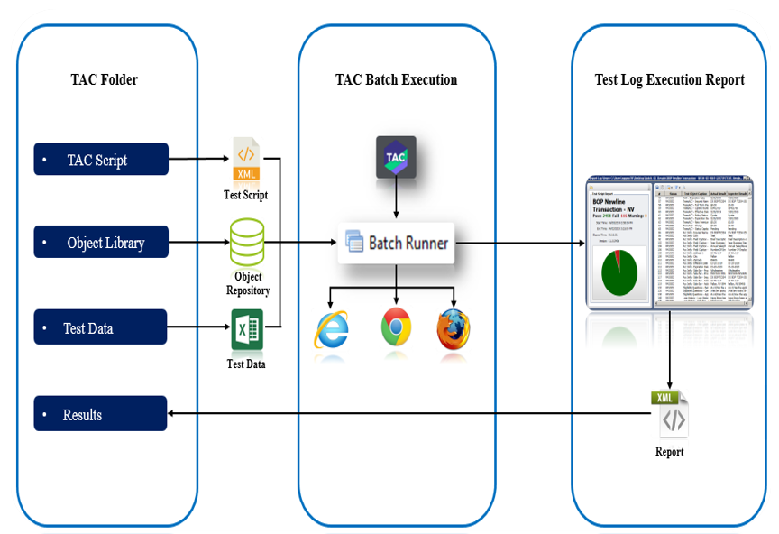
Test Automation Center Framework

Slide 15
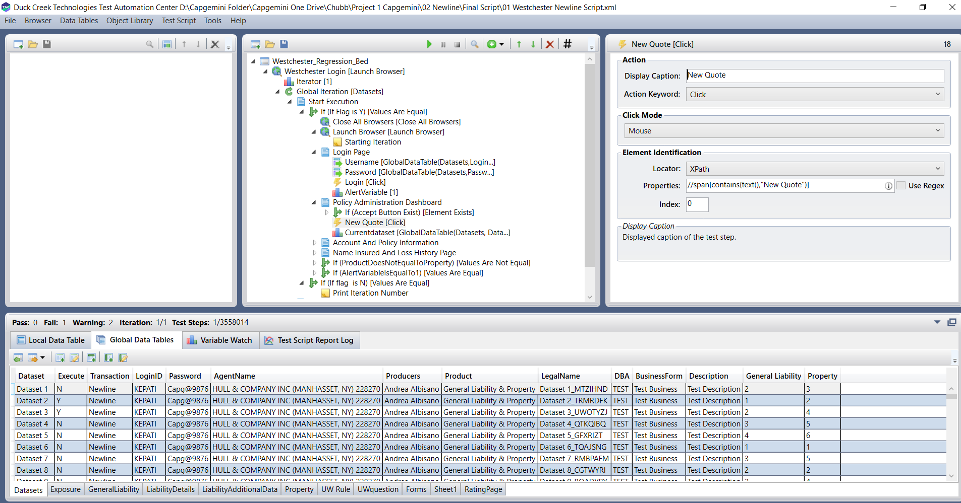
Duck Creek Test Automation Tool

Slide 16
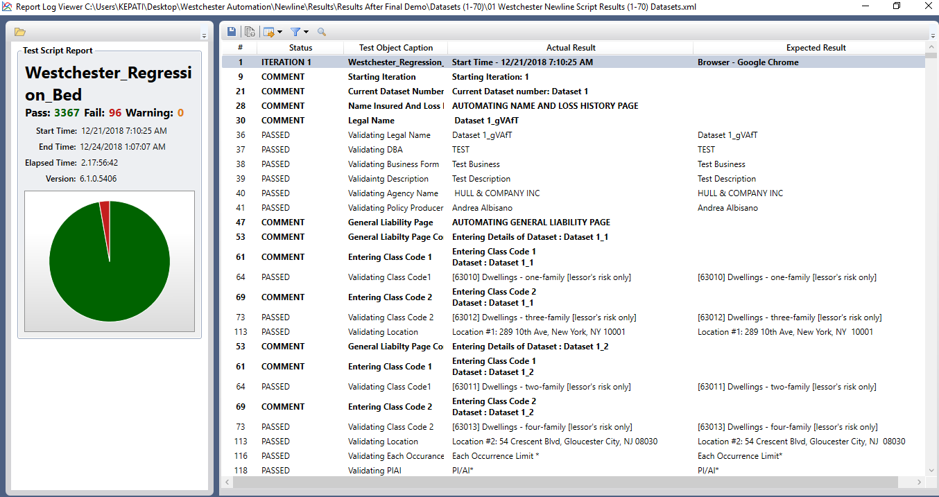
Reporting

Slide 17
Advantages of using SRS Document
The project’s business objectives, vision and scope will be clearly defined.
All the requirements will be categorized according to the priority by the customer, so the developers will not encounter ambiguities and missing information while coding.

Slide 18
Advantages of using SRS Document
It provides client a satisfaction as this is the first response to the client.
It defines functional and non-functional requirement.
It eliminates any confusion or misunderstanding on initial stage.
It reduces development effort.
It reduces the chances of requirement creep.
It makes testing easier.

Slide 19
Disadvantages of using SRS Document
SRS should not contain any design requirement or design detail.
It required pictures, tables, charts (bar, worm, etc…).
Time Consuming

Slide 20
References
Object-Oriented Software Engineering by Yogesh Singh & Ruchika Malhotra, PHI Learning Pvt. Ltd., 2012
https://krazytech.com/projects/sample-software-requirements-specificationsrs-report-airline-database

